Slide 1
NAWEZA TENA PROJECT (Empowering Drug Addicts and Sex Workers to Improve their Lives)

Slide 2
NAWEZA TENA is a non-governmental organizationregistered in April 2022 under the Non-Governmental Organization Act of 2002 with registration No 14NGO/R/3187 that aims to provide opportunities for drug addicts and sex workers living in dangerous environment to change their lives by doing proper jobs and business and redeem themselves back to the community. We believe that everyone has the potential to change their lives for the better, and our organization is dedicated to providing the necessary resources and support to help them do so.

Slide 3
Drug addiction and sex work are two significant issues affecting many individuals in Mwanza, Tanzania. Here are some of the challenges facing drug addicts and sex workers in Mwanza, Tanzania, along with relevant citations:
Stigma and discrimination: Drug addicts and sex workers in Mwanza face social exclusion, stigma, and discrimination. They are often viewed as social outcasts, and their human rights are frequently violated. As a result, many individuals are reluctant to seek help or access health care services. (Mmbaga et al., 2018)
Limited access to harm reduction services: Harm reduction services, such as needle exchange programs and opioid substitution therapy, are not widely available in Mwanza. This puts drug addicts and sex workers at a higher risk of contracting HIV and other blood-borne infections. (Mmbaga et al., 2018)
Lack of vocational training opportunities: Many drug addicts and sex workers in Mwanza lack the skills and knowledge needed to transition out of these activities. There are limited vocational training opportunities available to help individuals gain the skills they need to secure alternative employment. (NACADA, 2018)

Slide 4
NAWEZA TENA's primary objective is to empower drug addicts and sex workers to improve their lives. To achieve this, we have set the following goals:
1.To provide a safe and supportive environment for drug addicts and sex workers to access services and resources.
2.To offer counselling, mental health support, and harm reduction services to individuals affected by drug addiction and sex work.
3.To facilitate access to health care services, including HIV testing and treatment, for drug addicts and sex workers.
4.To provide vocational training and job placement services to help individuals transition out of drug addiction and sex work.
5.To raise awareness about drug addiction and sex work and reduce stigma associated with these issues.

Slide 5
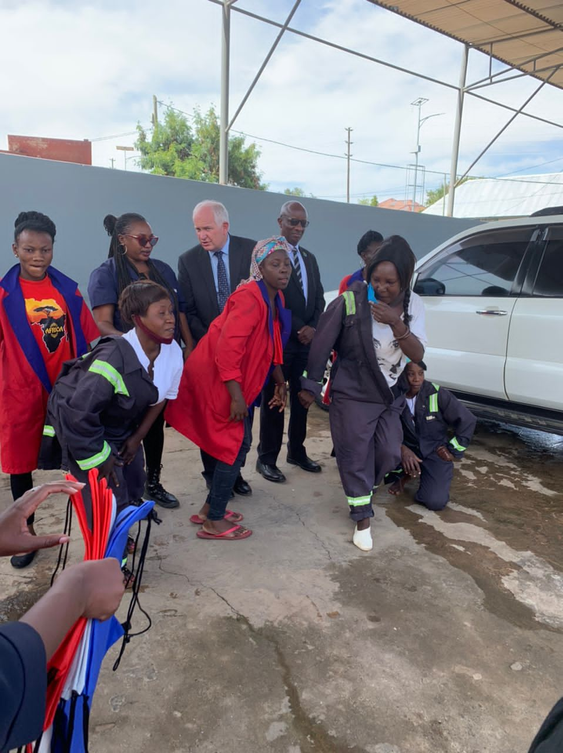
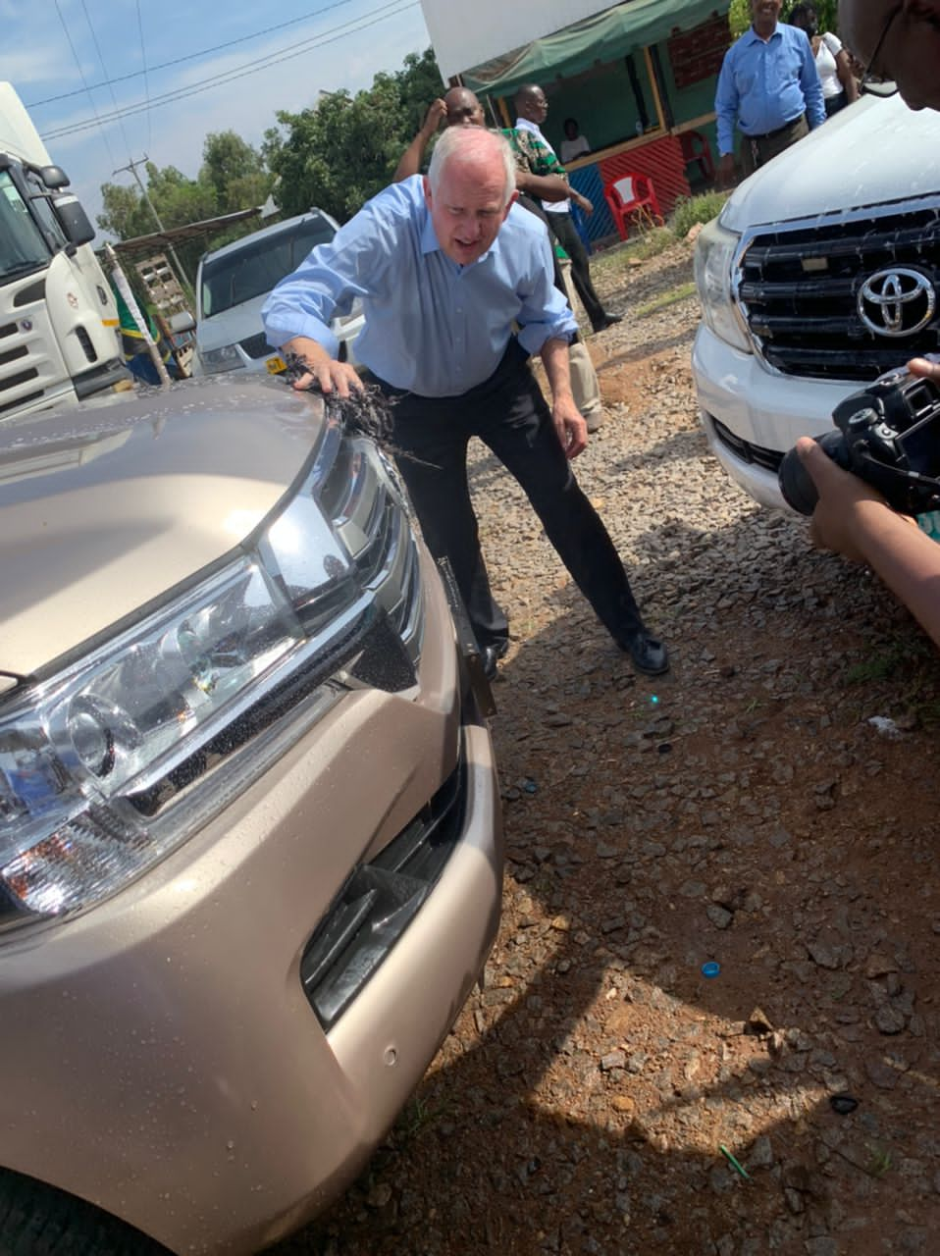
Car washing project for sex workers and drug addicts
On going car washing project
2021 US Ambassadors visit( Hon.Donald Wright)

Slide 6
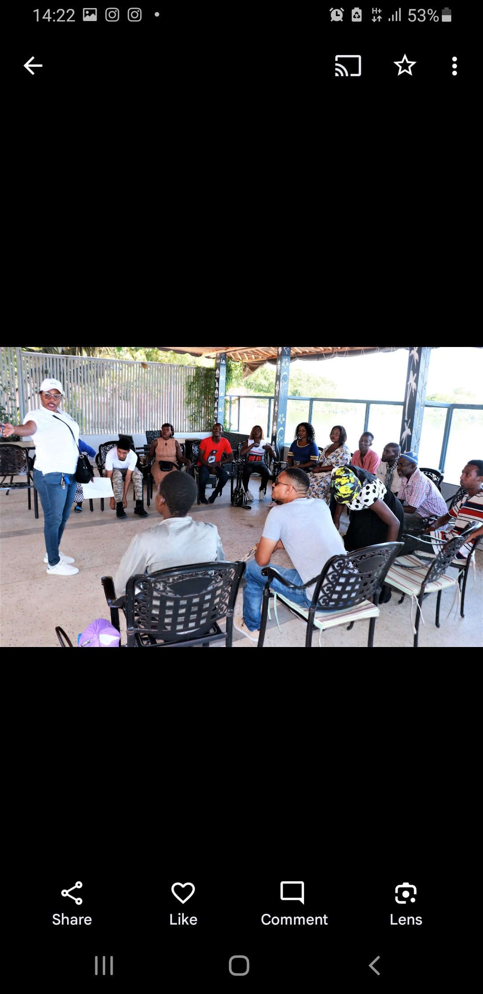
Expected Outcomes
1. Improved physical and mental health for drug addicts and sex workers.
2. Increased access to health care services, including HIV testing and treatment, for drug addicts and sex workers.
3. Increased awareness about drug addiction and sex work, and reduced stigma associated with these issues.
4. Increased job opportunities for individuals who have transitioned out of drug addiction and sex work.
5. Improved social inclusion and reduced discrimination for drug addicts and sex workers

Slide 7
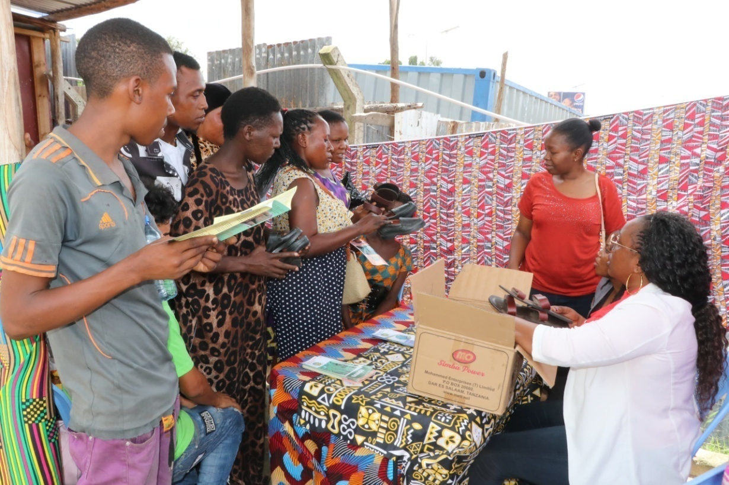
Conclusion:
NAWEZA TENA is committed to economically empowering drug addicts and sex workers to improve their lives. By providing access to support services, health care, vocational training, and job placement services, we believe that individuals affected by these issues can overcome the challenges they face and lead fulfilling lives.

